Slide 1
Capstone Presentation
Sales Forecasting

Slide 2
Business Problem Understanding
Problem Statement – Forecasting Sales and providing business insights and strategies for the sale in different products across different cities
Dataset is limited to only Q1 in 2018- Might affect forecasting data
Exploring different techniques in forecasting models and applying the same based on trend and seasonality
Forecasting sales to determine various products in different cities and provide insights to the company

Slide 3
Project Context
Abstract :
Sales Forecasting
Constraints
Introduction :
4800 records, 4 variables[Products, Date, Cities, Sales]
Approach :
Univariate/Bivariate Trends and insights
EDA Insights
Model Building :
Model Selection
Outcome:
Best Performing Model
Conclusion & Recommendation:
Classification of Products based on Sales
Recommendation for products

Slide 4
Solution Approach
Insights Using :Univariate and Bivariate analysis
EDA :
City Vs Sales
Product Vs Sales
City Vs Product Vs Sales
Model building:
Simple average
Simple Exponential
Triple Exponential
ARIMA
SARIMA
Prophet
Model Selection:
Based on Trend and Seasonality
Trend – ARIMA Model
Trend & Seasonality – triple Exponential and SARIMA Model,Prophet
Apply Domain understanding to understand the features
Prepare recommendations based on insights collected.

Slide 5
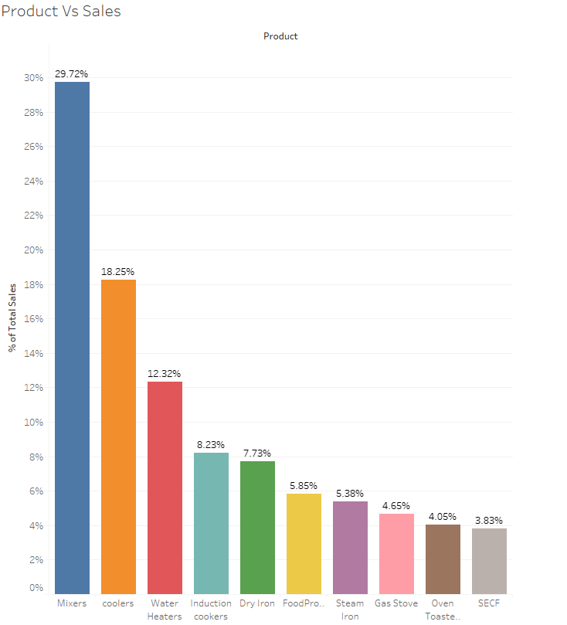
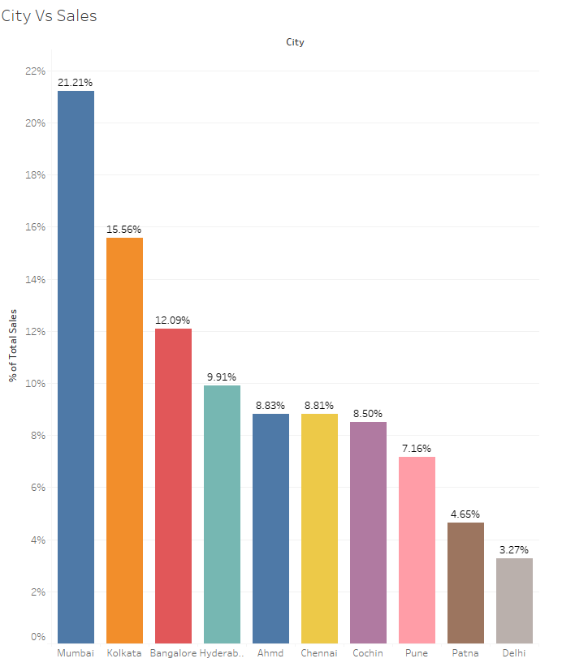

Slide 6
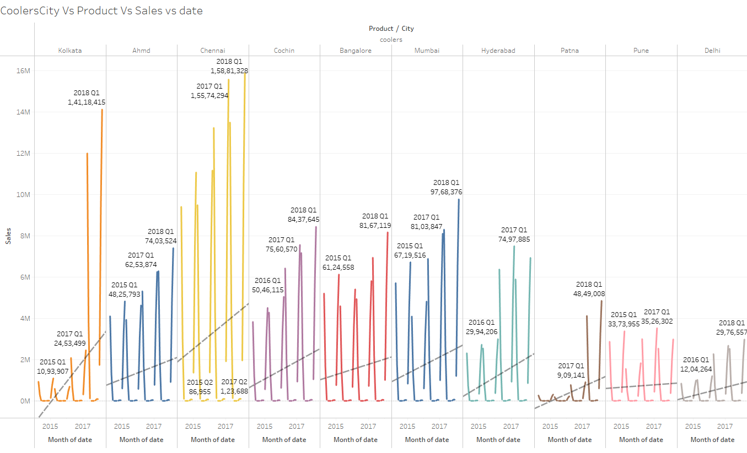

Slide 7
EDA Insights
Mumbai has the highest sales and Delhi has the lowest sales
Mixers has the highest sales and SECF has the lowest sales
Coolers is seasonal product with maximum sales in Chennai and followed by Kolkata
Dry Iron – Sales are in upward trend in almost all cities
Food processor – sales has downward trend in almost all cities
Induction Cookers – Sales is moderate in Ahmd, Chennai, Cochin and Delhi
Water Heaters- seasonal pattern with maximum sales in Kolkata, Cochin. Mumbai has moderate sales
Gas Stove – Sales has Upward trend in all cities

Slide 8
Model Approach
Broke down the dataset into data frame with each product and city To exemplify, Mumbai and Mixers and proceeded with the modelling approach
For seasonal dataframe applied Triple exponential , SARIMA models, Prophet models
For dataframes with trend alone applied ARIMA , Simple and Double exponential models
Triple exponential did well in almost all seasonal dataframe
ARIMA did well in all dataframe with trend and no seasonality.

Slide 9
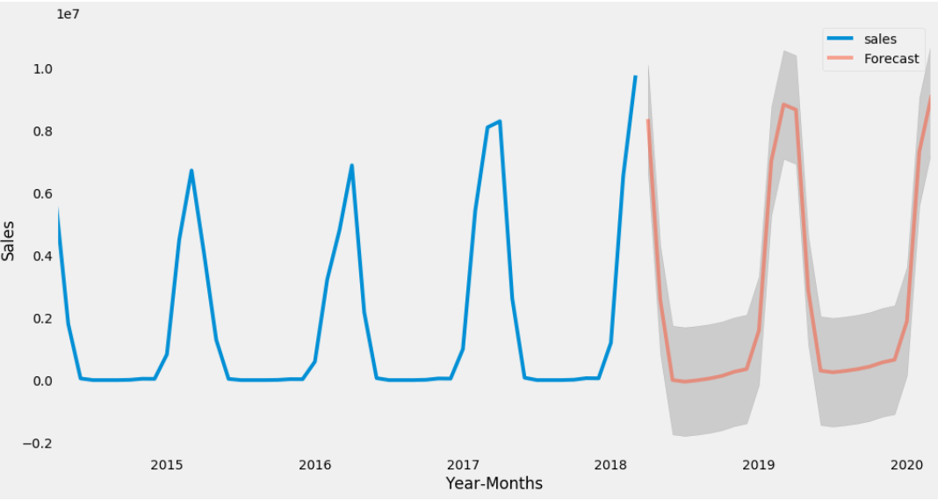
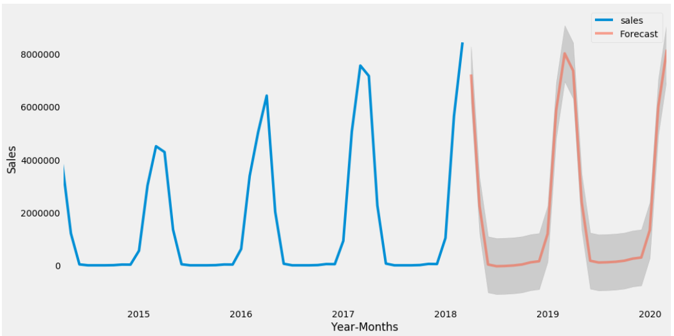
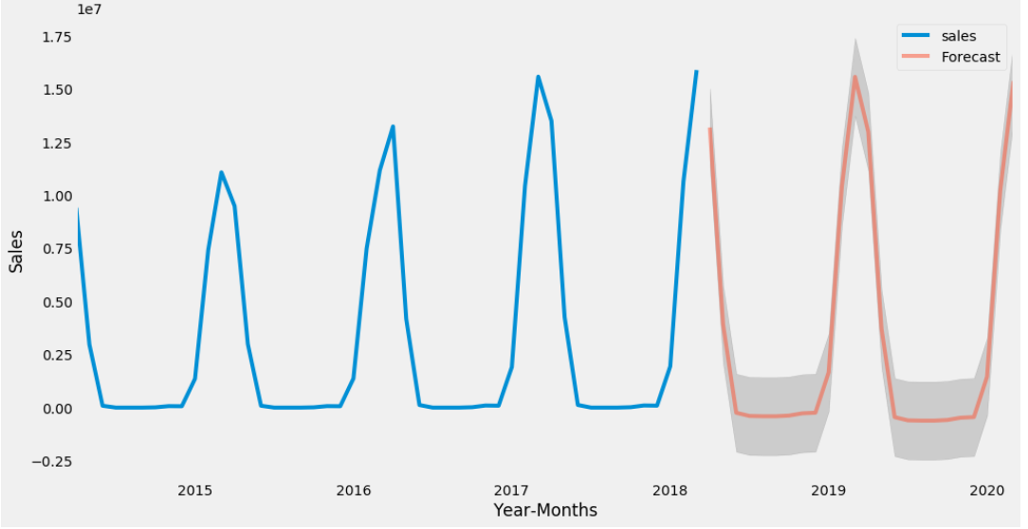
Coolers - Mumbai
Coolers- Cochin
Coolers - Chennai
 | Test RMSE
Alpha=0.0403,Beta=0.0001,Gamma=0.0001,TripleExponentialSmoothing | 2.23E+06
Alpha=0.1,Beta=0.2,Gamma=1.0,TripleExponentialSmoothing | 1.73E+06
SARIMA(0,1,0)(3,1,0)6 | 6.39E+15
SARIMA(0,1,0)(0,1,2)12 | 3.99E+12
Prophet | 3.69E+12

Slide 10
Insights from Analysis
Coolers have seasonal component, hence the sales forecasting also have the same with upward trend in all cities
Dry Iron – Bangalore have a flat line in forecasting and pune has downward forecasting line, other cities has upward forecasting
Food Processor – Pune have flat line forecasting, Mumbai has a slight elevated upward forecasting trend and Bangalore on the other hand have downward trend. Cochin, having least sales also have flat line forecasting
Gas Stove – Cochin and Mumbai has an upward forecasting trend. Bangalore(least sales) and Ahmd has unusual flat line forecasting. All other cities have upward forecasting
Induction Cookers - Kolkata having highest sales have sales dropping in the forecasting. Bangalore and Hyderabad have flat line forecasting. Cochin has least sales and a flat forecasting line

Slide 11
Insights from Analysis
Steam Iron – Bangalore and Delhi has an upward trend. Other cities have flat line forecasting trend and pune having downward forecasting trend.
Water heaters – Delhi having least sales have an upward trend, other cities have good forecasting of sales, however cochin has downward trend of forecasting
Sales in all cities have an upward trend except pune which has a flat line
SECF also have an upward sales trend overall.
Overall sales of food processor has an downward trend

Slide 12
Recommendations
Delhi has the lowest sales in all products, hence being the capital city, sales, production, strategies have to be revisited.
Coolers and water heaters have sales almost zero in some months, hence production have to be limited during off season and stock products during highest sales.
Dry iron- Bangalore having the highest sales, have flat line forecasting hence sales strategies have to be altered to keep the trend up by giving promotional offers
Food Processor – Strategies should be changed in pune(second highest sales) and Bangalore having flat line and downward forecasting respectively and plan production of products accordingly.
Gas Stove – Bangalore and Ahmd has moderate sales with flat line forecasting. Sales strategies have to be revisited to bump up the sales

Slide 13
Recommendations
Induction Cooker- Sales strategies have to altered for induction cookers to keep the product good in the competitive environment
Steam Iron – Other than Bangalore and Delhi. Sales strategies have to be changed with production of products altered in all cities since they have flat line and pune with downward trend
Water heaters – Sales strategies have to be altered for cochin, since sales have downward forecasting
Overall sales in pune has flat line or downward line except water heaters., hence market strategy has to be changed for sales and production of product has to be limited than other cities.
Stock of Food processor might have to be re-evaluated.

